Slide 1


predatoR Mutation Impact Prediction Based on Network Properties
Berk Gürdamar, MSc

Slide 2
Mutation Impact Prediction
Approach for classifying mutations as pathogenic or neutral using several different information.
Sequence
Structure
Thermodynamic
Machine learning

Slide 3
Why is Mutation Impact Prediction Important?
Functional analyses on large numbers of variations is generally impractical
Experimental approaches are time consuming and costly
Variant prioritization
Most nonsynonymous variants are neutral
Variant of uncertain significance (VUS)

Slide 4
Aim
Build a new method by using network formalization from protein structures for identifying missense variants most likely to
Have pathogenic effect
Contribute to a disease

Slide 5
History of Mutation Impact Prediction
Sequence conservation-based methods
Probabilities of amino acid substitutions
Position-specific probabilities
Structure-based methods
ΔΔG
Combined methods
Sequence and structure
Meta-prediction methods
Scores from multiple predictors

Slide 6
Mutation Impact Prediction Tools
PolyPhen-2
Sequence and structure
Naïve Bayes Classifier
SIFT
Sequence homology
Rhapsody
Sequence, structure and dynamics-based features
Random forest
CONDEL
Meta-predictor
Predictions from 5 different predictors

Slide 7
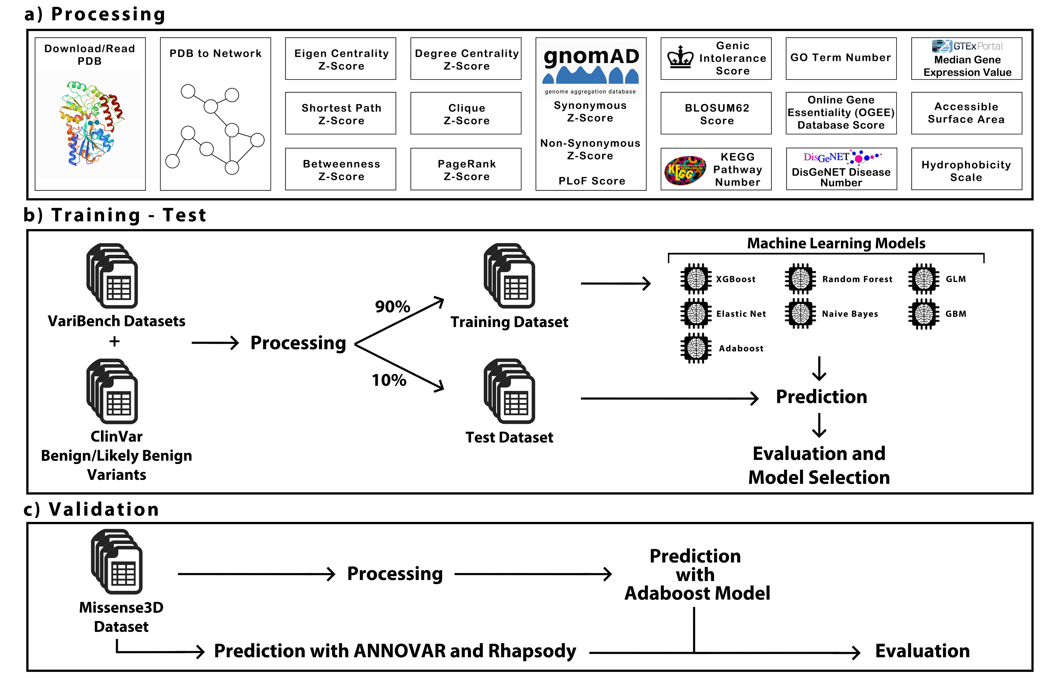
Overall Workflow

Slide 8
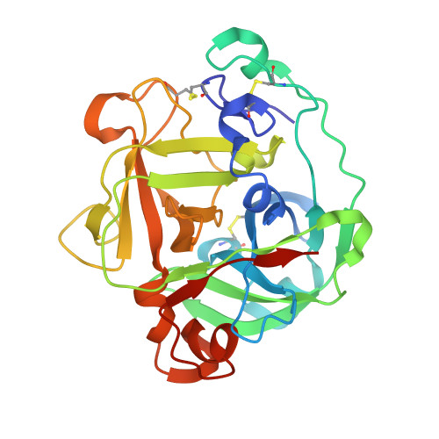
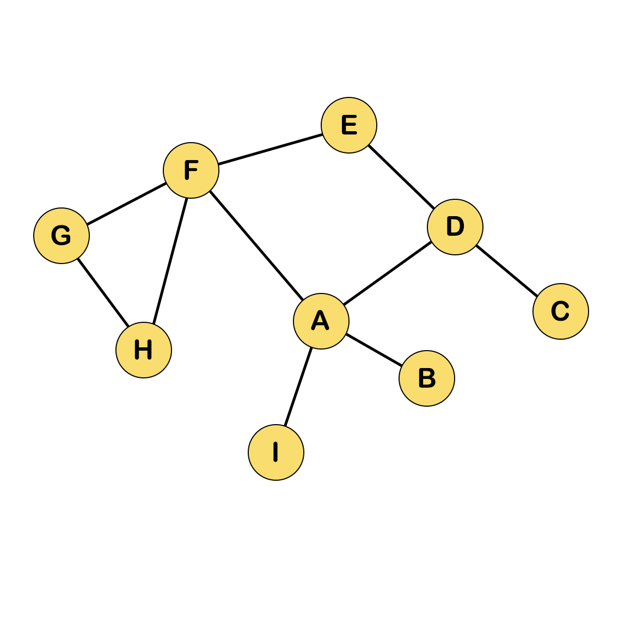
Network Formalization from PDB structures
Create Edge List
Download/Read PDB
Node1 | Node2
A | B
A | D
A | F
A | I
B | A
C | D
D | A
D | C
D | E
E | D
. | .
. | .
. | .
Build Network

Slide 9
Network Formalization Approaches
5Å
All atoms approach
7Å
5Å
Cα atoms approach
7Å

Slide 10
Processing - Features
24 unique features
6 network-based
9 gene-based
9 amino acid-based

Slide 11
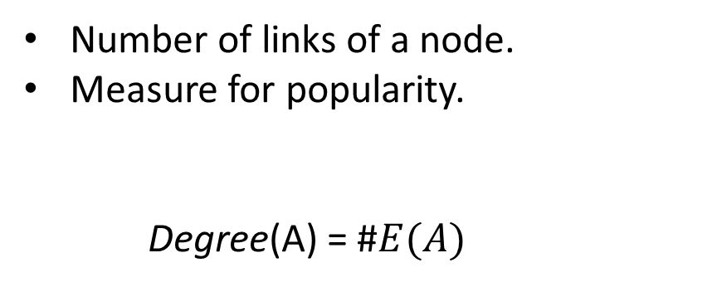
Network-based Features – Degree Centrality
Number of links of a node.
Measure for popularity.
Degree(A) = #$E(A)$

Slide 12
Network-based Features – Eigen Centrality
Number of links of neighbors of a node.
Measures the influence.
Eigen(A) = Degree(B) + Degree(D) + Degree(F) + Degree(I)

Slide 13
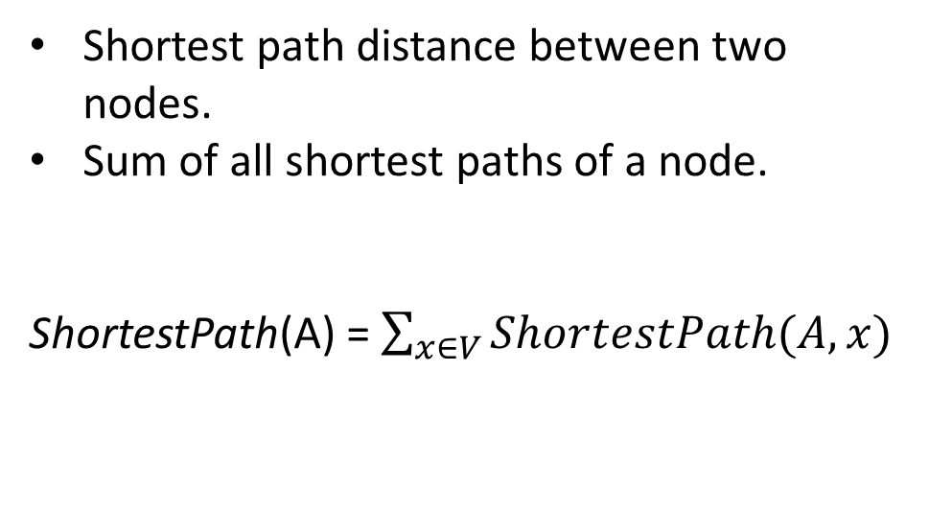
Network-based Features – Shortest Path Score
Shortest path distance between two nodes.
Sum of all shortest paths of a node.
ShortestPath(A) = $\sum_{x∈V}{ShortestPath(A,x)}$
2
1
1
2
2
2
1
1

Slide 14
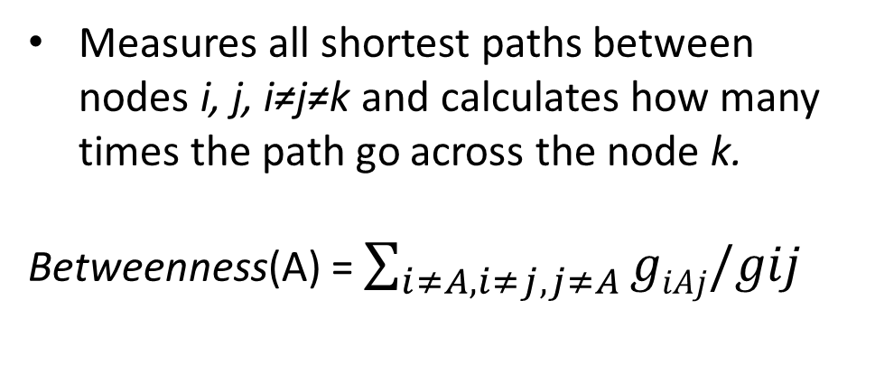
Network-based Features – Betweenness Centrality
Measures all shortest paths between nodes i, j, i≠j≠k and calculates how many times the path go across the node k.
Betweenness(A) = $\sum_{i≠A,i≠j,j≠A}{giAj/gij}$

Slide 15
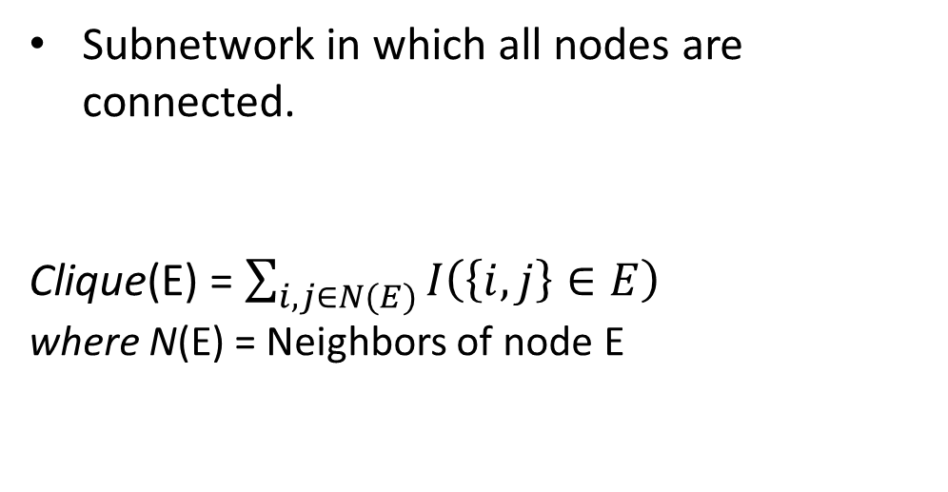
Network-based Features – Clique Score
Subnetwork in which all nodes are connected.
Clique(E) = $\sum_{i,j∈N(E)}{I\left(\left\{i,j\right\}∈E\right) }$/ $\left({Degree(H) \atop 2}\right)$
where N(E) = Neighbors of node E

Slide 16
Network-based Features – PageRank Centrality
0.190
0.102
Calculates the Google’s PageRank scores for each node.
Algorithm gives some approximation of a page's importance or quality.
0.099
0.158
0.188
0.061
0.099
0.062
0.040

Slide 17
Network-based Scores
Scores are calculated for each chain seperately.
Scores are converted to Z-scores for each chain.
Scores of Cα atoms of an input positions are used.

Slide 18
Gene-based Features
gnomAD metrics
Missense Z-scores
Synonymous Z-scores
Probability of loss of function intolerance (pLI)
Associated KEGG pathway number
Associated GO term number
Associated disease number from DisGeNET
Genic Intolerance score
Gene essentiality score from Online GEne Essentiality (OGEE) v3
Median gene expression values of genes from Genotype-Tissue Expression (GTEx) portal

Slide 19

gnomAD Metrics
Aggregated from sequencing of more than 125,000 exomes and 15,000 human genomes.
Constrain metrics are based on observed vs. expected number of rare SNVs of a gene.
Higher Z-scores and pLI scores indicates less tolerance to variation.

Slide 20

Number of Associated KEGG Pathways
KEGG database consists of 15 both manually and computationally curated databases.
All human KEGG pathways and associated genes were used.

Slide 21
Number of Associated GO-BP Terms
The aim of GO is creating a controlled language and apply it to all eukaryotes.
GO categories:
Biological process,
Molecular function,
Cellular component
Filters:
Biological process domain
Experimental evidence codes (EXP, IDA, IPI, IMP, IGI, IEP, HAD, HMP and HEP) related terms

Slide 22
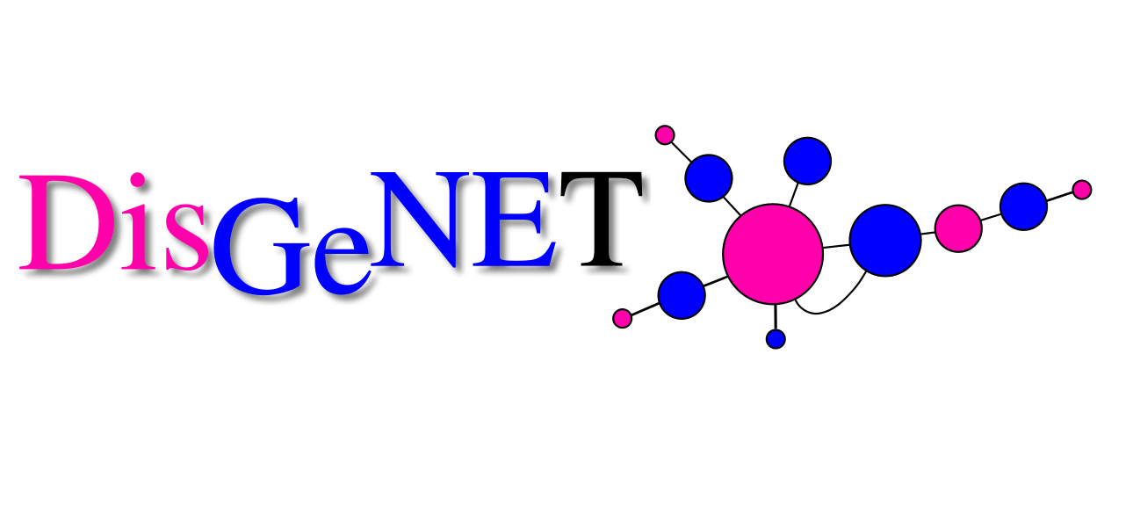
Number of Associated Diseases from DisGeNET
DisGeNET is a human database for gene-variant associations with diseases.
Integrates:
Curated datasets from experts,
GWAS catalogue,
Literature,
Animal models
Curated gene-disease associations dataset.

Slide 23

Genic Intolerance Score
6,500 whole exome sequencing data.
Score that based on observed and expected number of variations found on a gene.
Filters:
Minor allele frequency (MAF) filter at 0.1%

Slide 24
Gene Essentiality Score from OGEE v3
Large-scale gene essentiality experiments
NCBI PubMed database
Model organisms
Drosophila melanogaster, Caenorhabditis elegans, Saccharomyces cerevisiae and Arabidopsis thaliana
Collection of known factors influencing gene essentiality
Functional annotation of a gene
Early expression during embryonic development

Slide 25
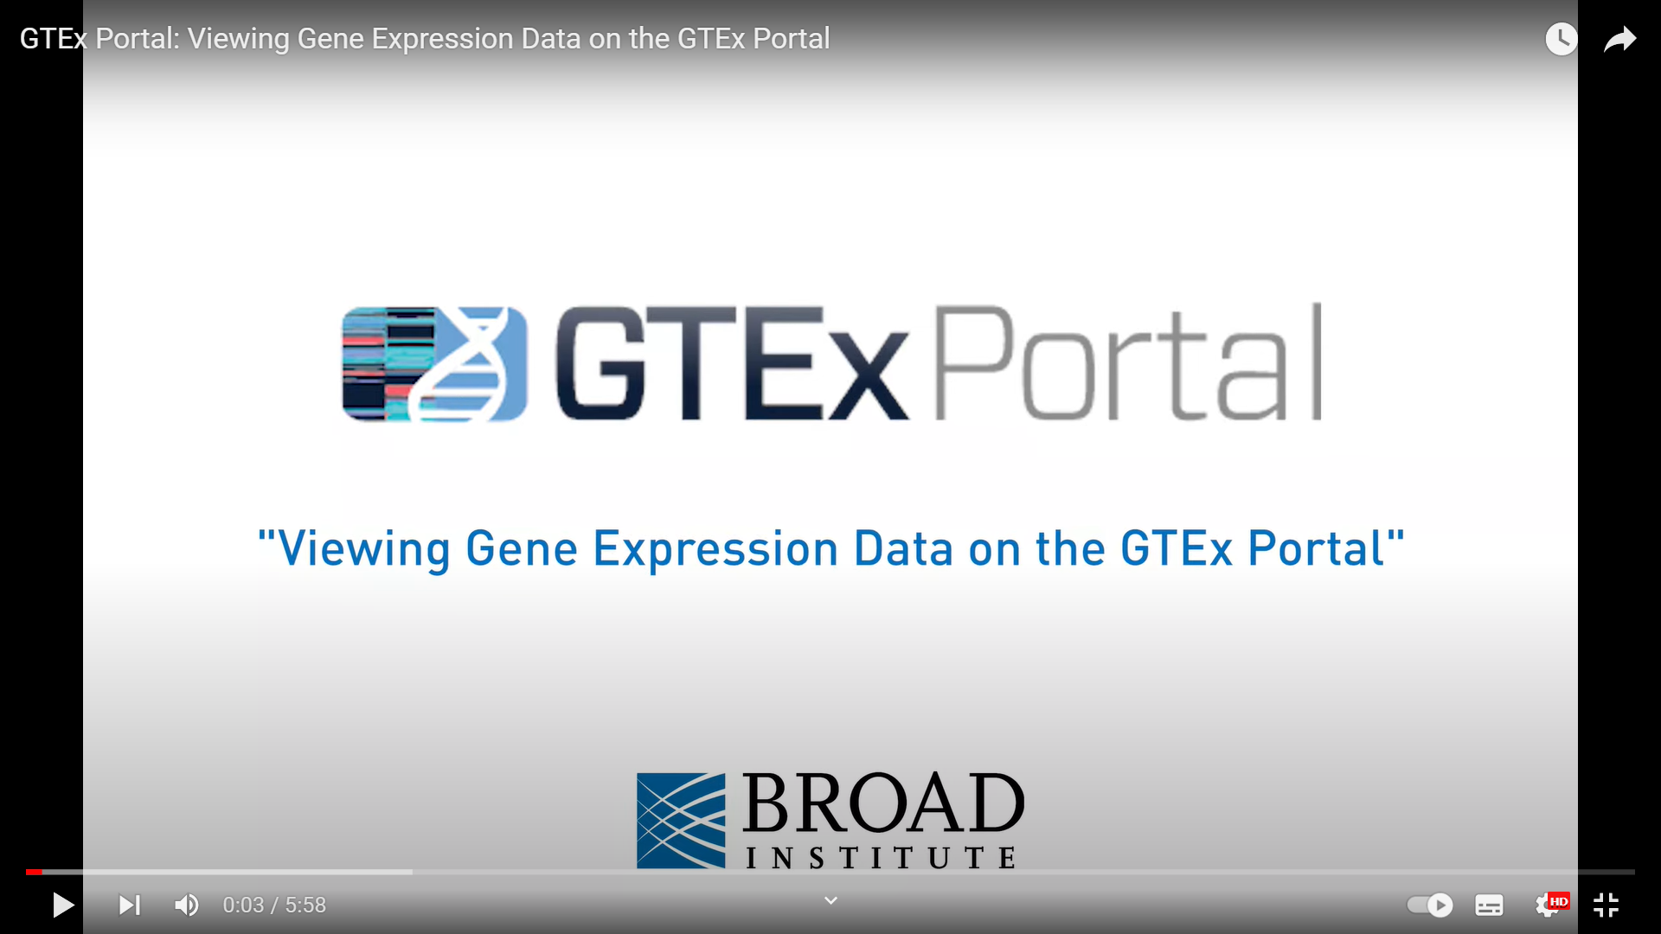
Gene Expression Values from GTEx Portal
Contains tissue expression datasets for multiple tissues.
Aim is to study the relationship between genetic variation and gene expression in human tissues.
Dataset:
Tissue-specific median transcript per million (TPM) gene expression dataset.
Contains gene expressions for 54 different tissue types.

Slide 26
Amino acid-based Features
Reference Amino Acid (Categorical)
Mutant Amino Acid (Categorical)
BLOSUM62 score
Accessible Surface Area (ASA) (Radzicka et al.)
ASA of reference amino acids
ASA of mutant amino acids
ASA difference between mutant and the reference amino acids
Hydrophobicity Scale (Juretić et al.)
Hydrophobicity scale of reference amino acids
Hydrophobicity scale of mutant amino acids
Hydrophobicity scale difference between mutant and the reference amino acids

Slide 27
Datasets
VariBench
Neutral Datasets: DS2, DS4, DS6, DS8, DS10, DS12, DS14, DS16, MMR and dbSNP
Pathogenic Datasets: DS3 and DS5
Training dataset of Rhapsody
ClinVar
Benign and likely benign variants
Missense3D
Experimental datasets

Slide 28
Datasets – Model Training/Testing
VariBench Datasets
30,546 mutations (6,983 neutral and 23,563 pathogenic)
ClinVar Dataset
>1,000,000 unique variations
Benign and likely benign variants were filtered
Final Dataset
48,005 mutations (24,496 neutral and 23,509 pathogenic)

Slide 29
Datasets – Method Comparison
Missense3D Datasets
10,229 mutations (4,652 neutral and 5,577 pathogenic)
Common mutation removal
6,554 mutations (3,569 neutral and 2,985 pathogenic)

Slide 30
Mutation Impact Prediction Models
Dataset after processing:
34,968 mutations (17,469 neutral and 17,499 pathogenic)

Slide 31
Model Validation/Comparison with Other Methods
Dataset after processing:
4,403 mutations (1,803 neutral and 2600 pathogenic)
Database used for ANNOVAR:
DBNSFP 4.2a
32 different prediction scores:
LRT
SIFT
SIFT4G
Polyphen2_HDIV
Polyphen2_HVAR
MutationTaster
MutationAssessor
FATHMM
PROVEAN
VEST4
MetaSVM
MetaLR
MetaRNN
M.CAP
REVEL
MutPred
MVP
MPC
PrimateAI
DEOGEN2
BayesDel_addAF
BayesDel_noAF
ClinPred
LIST.S2
DANN
fathmm.MKL_coding
fathmm.XF_coding
GenoCanyon
integrated_fitCons
GERP
CADD
Rhapsody

Slide 32
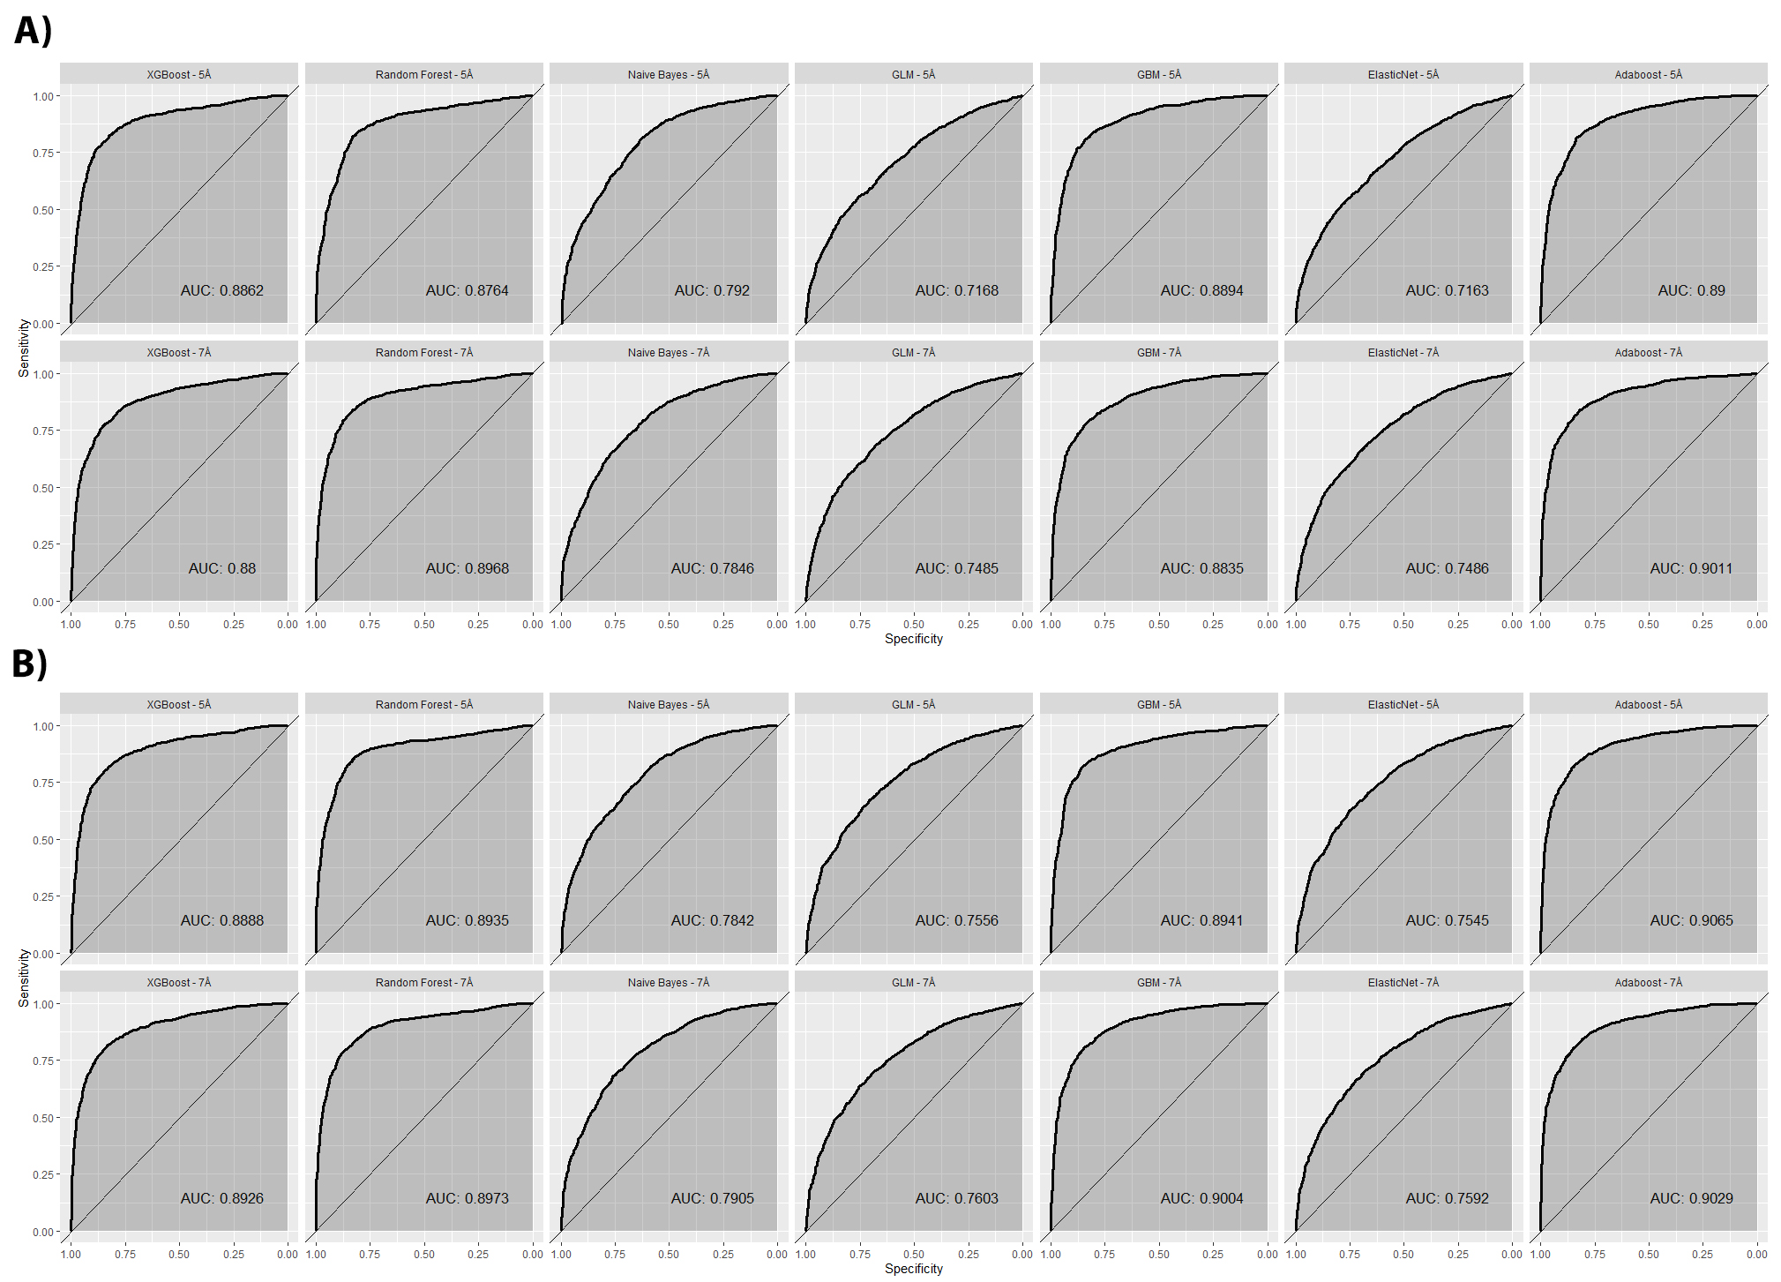
Test Dataset Results
Cα only
All atoms

Slide 33
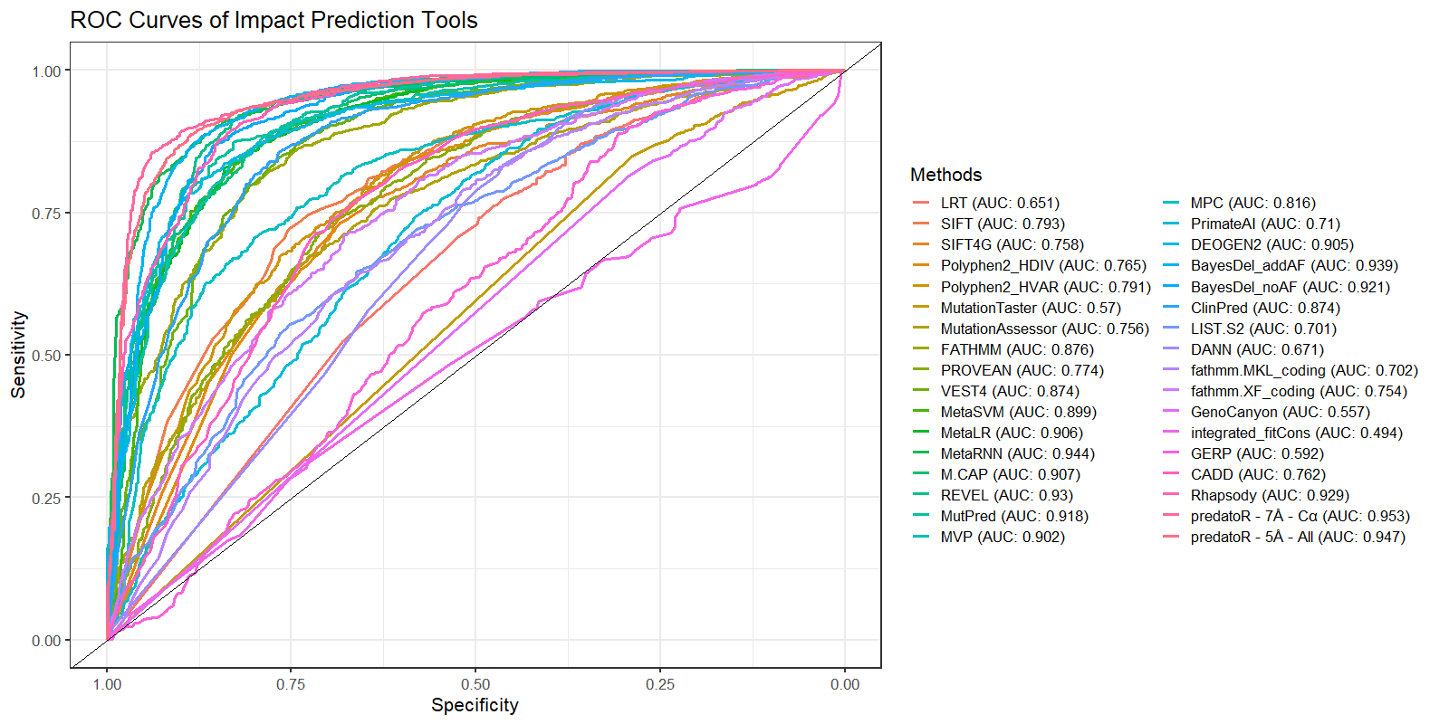
Comparison with Other Methods

Slide 34
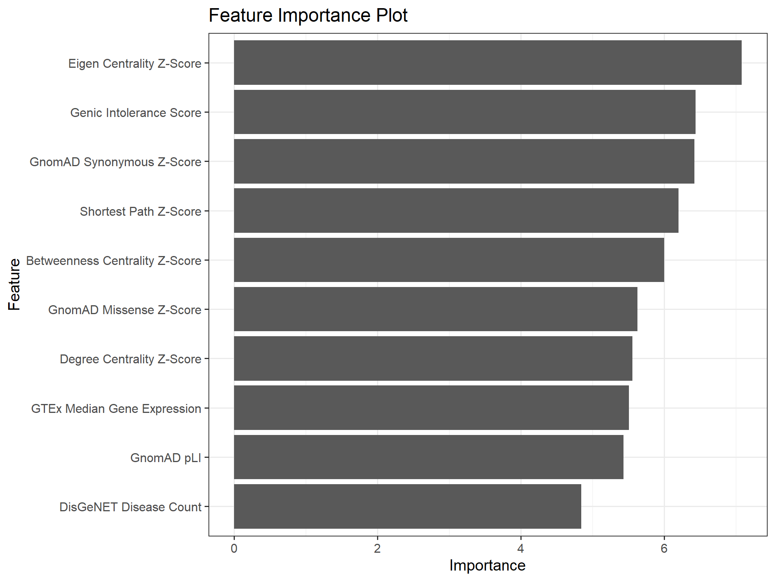
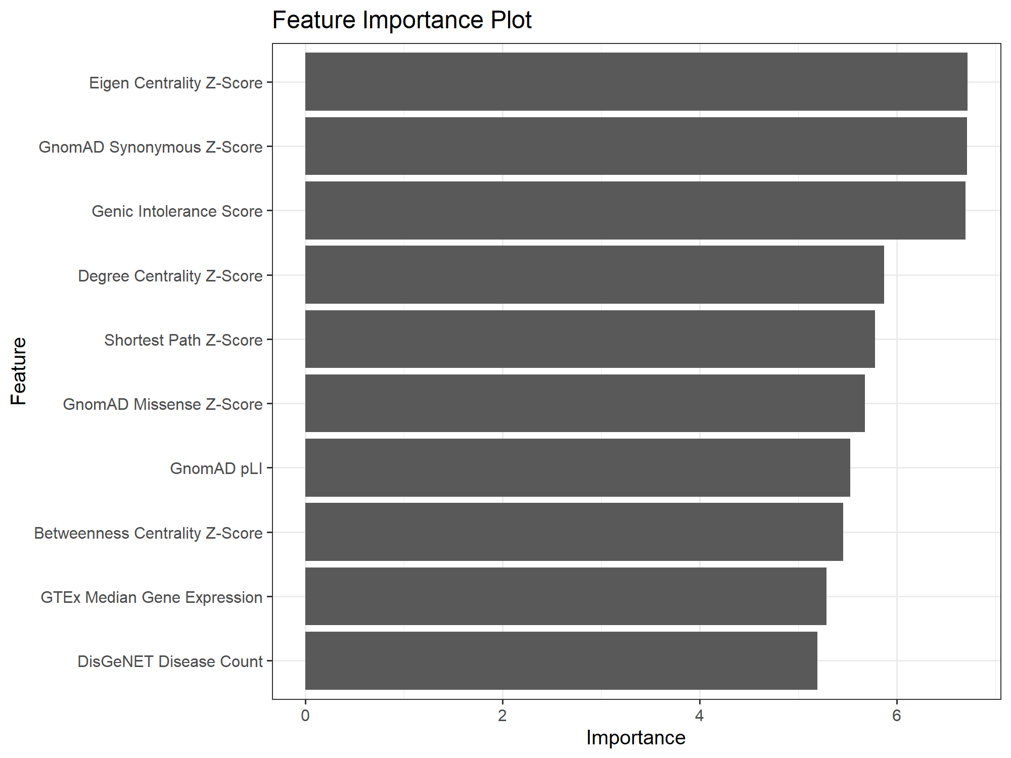
Feature Importance
All atoms approach
Cα atoms approach

Slide 35

predatoR R package
Consists of 19 functions:
predatoR
read_PDB
PDB2connections
betweenness_score
clique_score
degree_score
eigen_centrality_score
pagerank_score
shortest_path_score
DisGeNET
gene_essentiality
genic_intolerance
gnomad_scores
GO_terms
GTEx
KEGG_pathway_number
amino_acid_features
BLOSUM62_score
impact_prediction
2 models are included:
7Å – Cα atoms Adaboost
5Å – All atoms only Adaboost

Slide 36
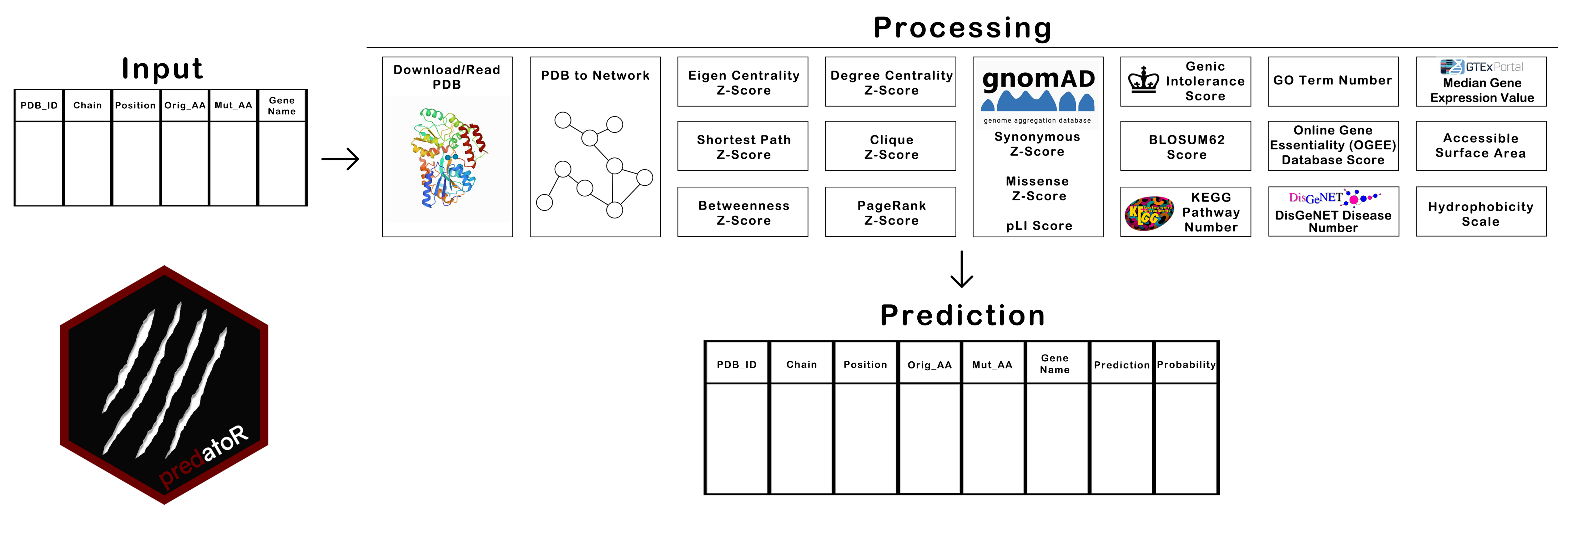
predatoR R package
predatoR is available on GitHub (https://github.com/berkgurdamar/predatoR)

